Slide 1

Predictive Analysis on Risk Factors associated with Obesity/overweight using BioDoopDetective
Final Presentation
Trimester-6th
Presentation By:
DIVYANSH GADWAL
MSDSM Batch-1
(2104107017)
Notes:
Biodoop is a revolutionary combination of bioinformatics and Hadoop that transforms the analysis of biological data. It effectively utilizes the scalability and distributed processing capabilities of Hadoop to handle vast amounts of genomic and biological datasets. By harnessing the parallel processing power of Hadoop, Biodoop empowers researchers and scientists to efficiently analyze and interpret intricate biological information.

Slide 2

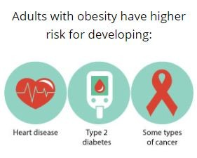
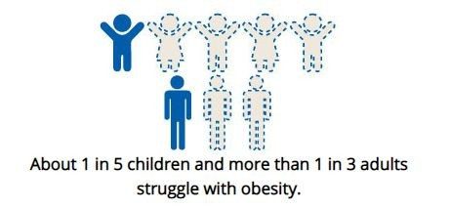
Introduction
Objective:
This project aims to analyze the relationship between obesity/overweight and various risk factors, including BMI, race, gender, physical activities, mental health, education level, etc.
Exploratory analysis of the dataset, the pre-modeling, and the development of different machine learning models to classify the risk factors of obesity.
Obesity constitutes a major public health concern in the U.S. and Globally
About 1 in 5 children and more than 1 in 3 adults struggle with obesity in the U.S. (CDC)
Adults with obesity have higher risk for developing Heart disease, Type 2 diabetes, and some types of cancer (CDC)
According to the “World Health Organization” (WHO), 30% of global death will be caused by lifestyle diseases by 2030.
There are limited number of studies using machine learning to analyze obesity related datasets in the U.S.

Slide 3
Research Questions/Approach
Research Questions:
Which variables are risk factors related to obesity?
What are the correlations between different risk factors and BMI?
Is mental health an important factor that correlates with obesity?
Which machine learning model can classify the dataset more accurately?
Approach:
Conduct EDA to find the relationship of different factors and produce visualizations
Find the most accurate model for our dataset.
Classification models (e.g Random Forest, Support Vector Machines (SVM), Logistic Regression, Decision Trees, and XGBoost)

Slide 4
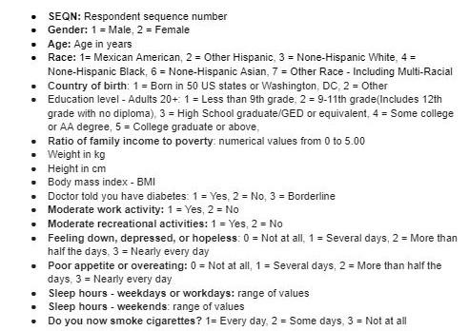
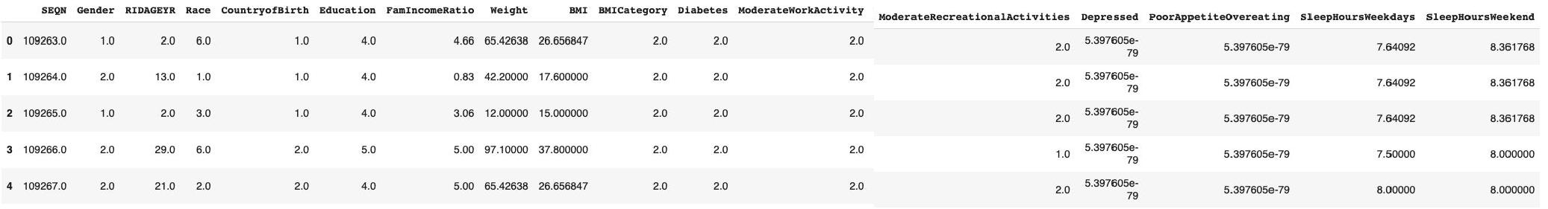
Dataset
Source:
CDC - National Center for Health Statistics. National Health and Nutrition Examination Survey March 2017 to 2020 Pre-pandemic
Combined 7 different raw datasets
Data type (numerical & categorical)
Data Size: 12.4MB - XPT. files

Slide 5
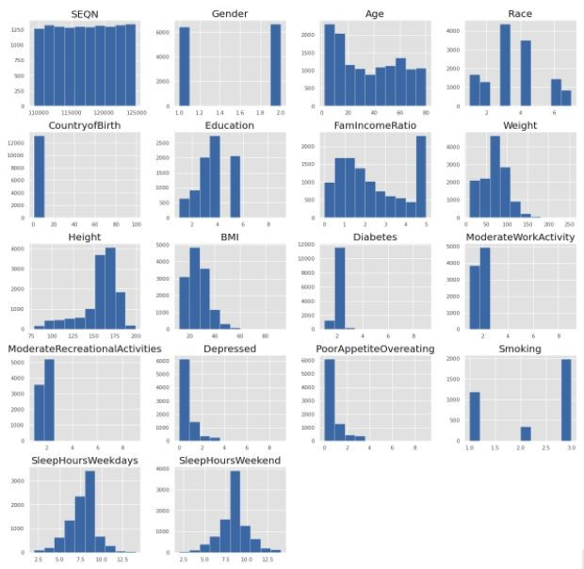
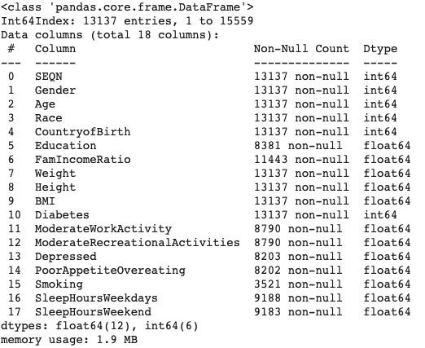
EDA & Visualizations
Basic histogram shows data distribution and frequency counts.

Slide 6
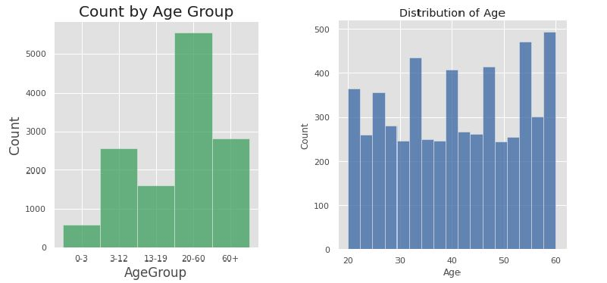
EDA & Visualizations
Dataset contains infants, children, teenagers, adults, and seniors.
Added a new column and separated respondents to different age groups.
Respondents below 20 or older than 60 years old - Missing information such as education, family income ratio, diabetes, activities, eating disorder status, and smoking habit.
Decided to extract the respondents’ data between 20 to 60 years old to a new data frame.

Slide 7
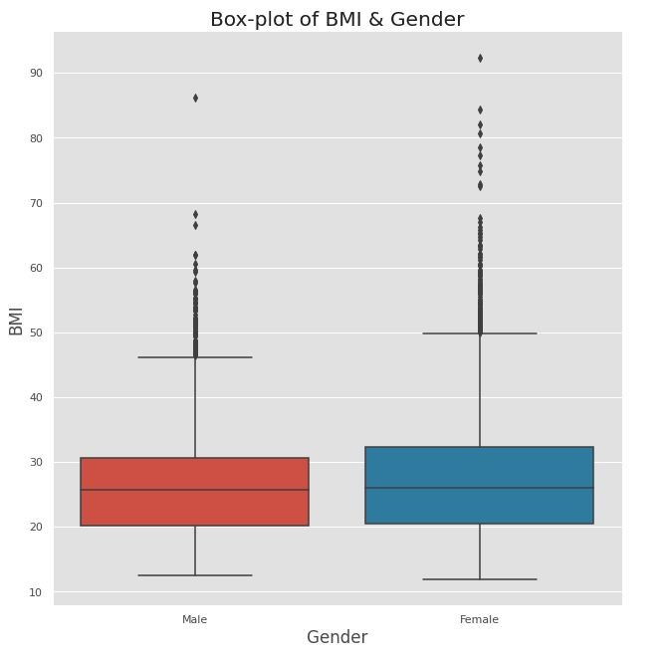
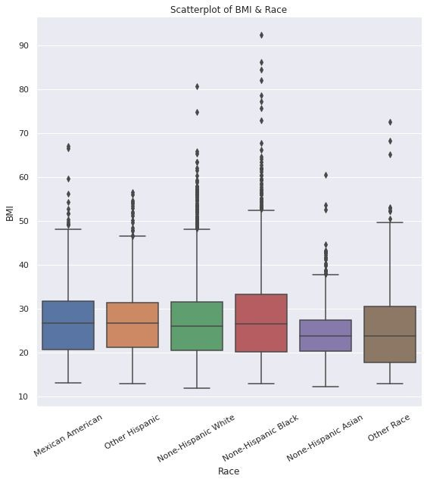
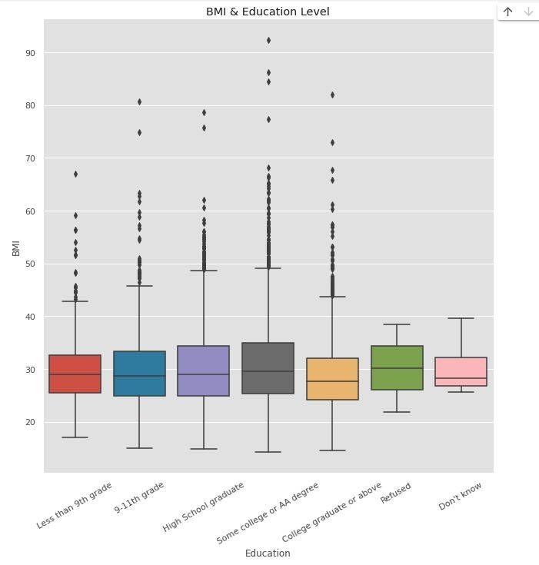
EDA & Visualizations
Female respondents have slightly higher BMI than Male respondents.
None-Hispanic Asians have lower BMI compared to other race groups in our dataset.
People with college or above education level tend to have lower BMI.

Slide 8
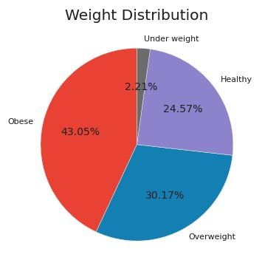
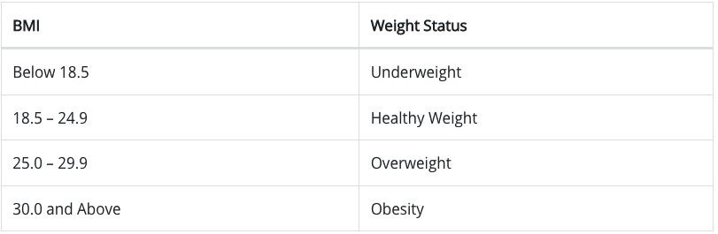
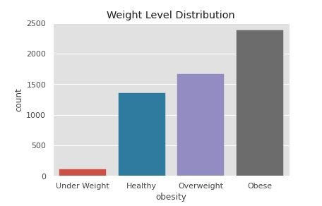
EDA & Visualizations
Added a column “obesity” showing weight level for each respondent based on CDC BMI guideline.
Obese: | 43.05%
Overweight: | 30.17%
Healthy: | 24.57%
Underweight: | 2.21%

Slide 9
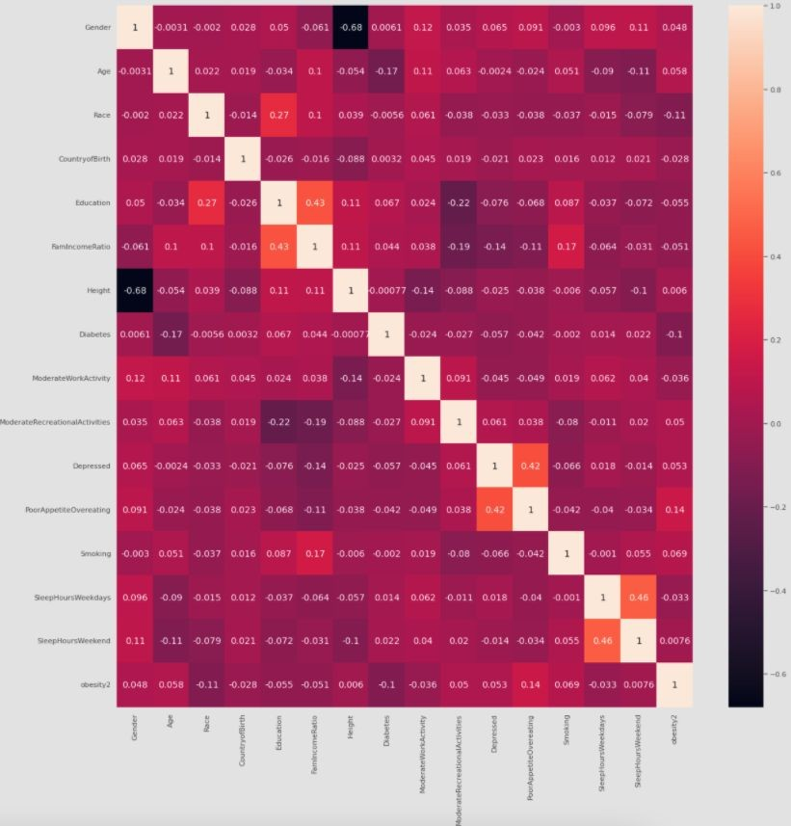
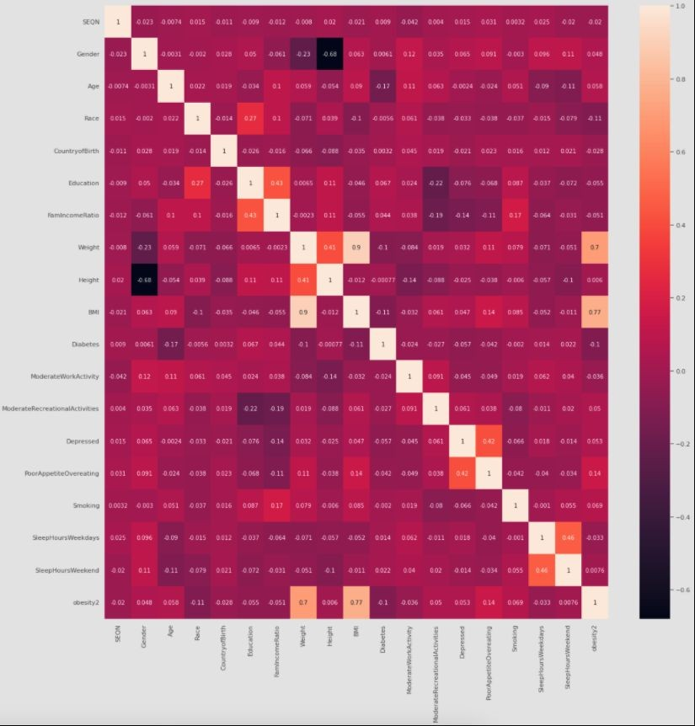
EDA & Visualizations
Heatmap shows the correlation between different risk factors.
Obesity level is highly correlated with weight and BMI.
After removing BMI and Weight, we can see that obesity level related to Poor appetite/overeating, diabetes, and race.
High correlation: Poor appetite/overeating and Depressed; Education and Family income ratio; Height and Gender;

Slide 10
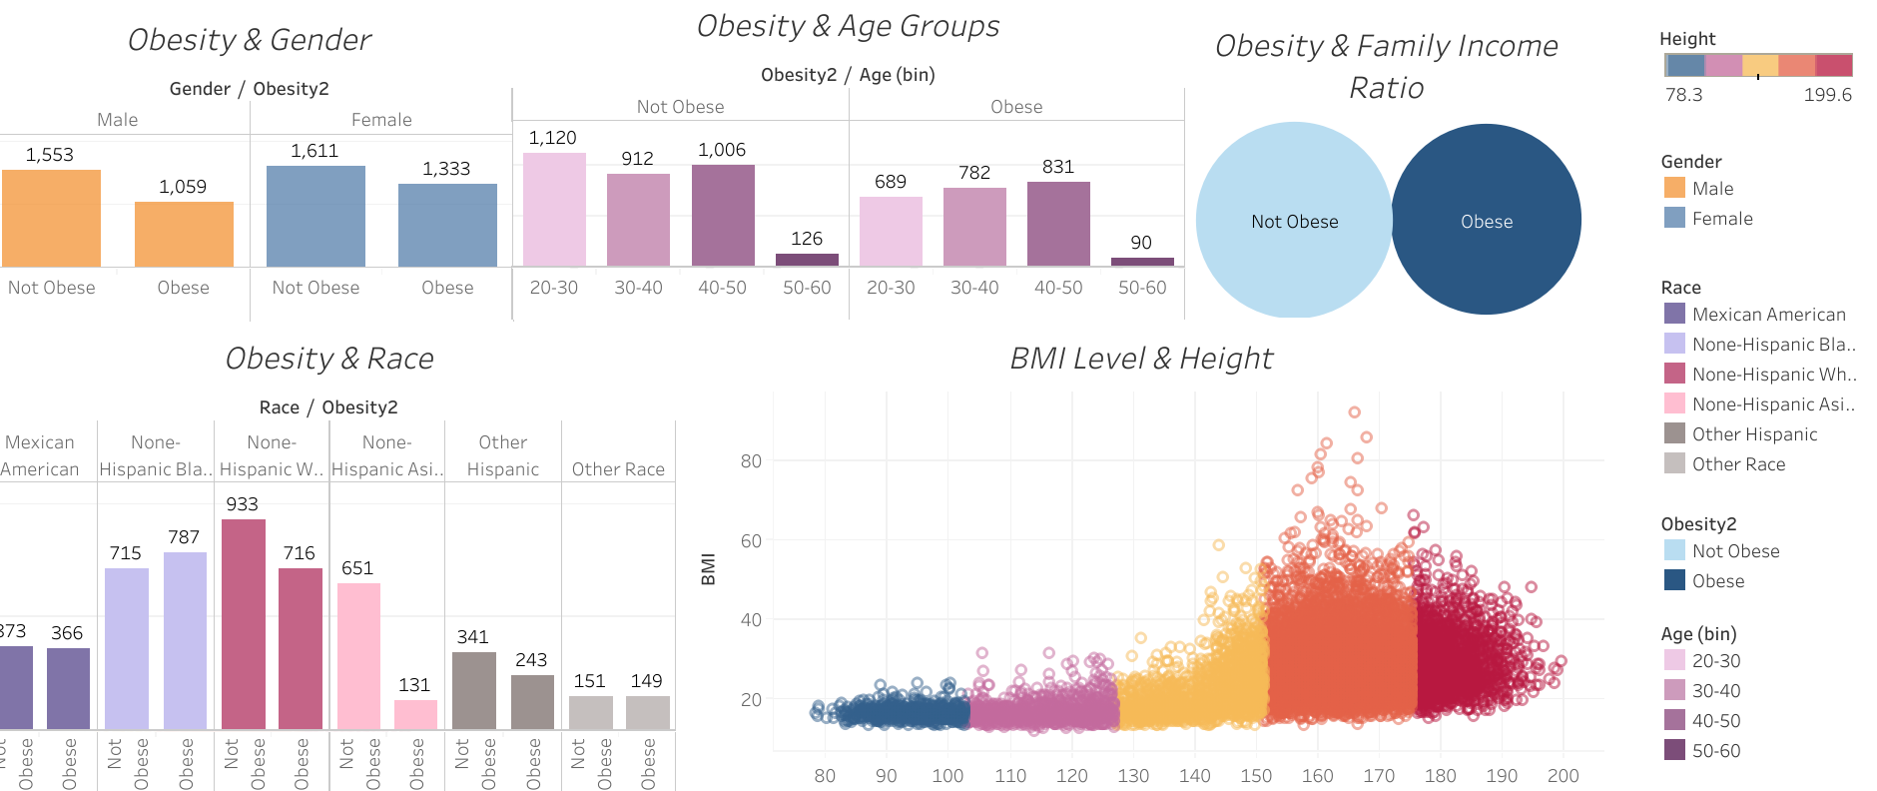
Dashboard
https://colab.research.google.com/corgiredirector?site=https%3A%2F%2Fpublic.tableau.com%2Fviews%2FVisualization_17054163694670%2FDashboard1%3F%3Alanguage%3Den-US%26%3Adisplay_count%3Dn%26%3Aorigin%3Dviz_share_link

Slide 11
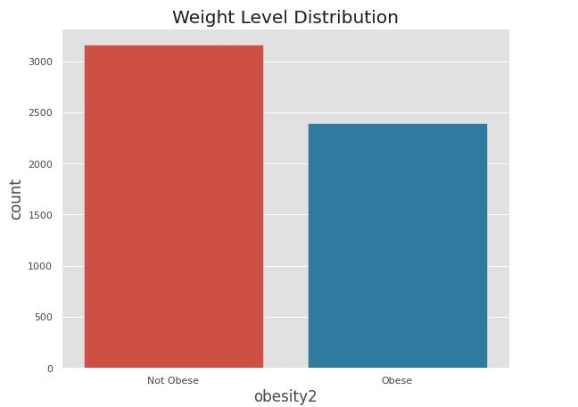
Preparation & Model Construction
After checking weight distributions we discovered that there was a class imbalance thus, we combined the respondents from the underweight, healthy, and overweight groups together and kept the obese group separate. (1 = Not Obese, 2 = Obese)
Dropped Weight and BMI from the dataset: Weight and BMI are highly correlated with obesity/overweight
Normalized the data using mean-max transformation which scaling each variable to the range (0, 1).
We split the data into training and testing sets at a 80% to 20% ratio.
For our modeling section, we used a total of 6 models: Baseline, Random Forest, Logistic Regression, SVM, Decision Trees, and XGBoost to predict accuracy and feature importance of risk factors

Slide 12
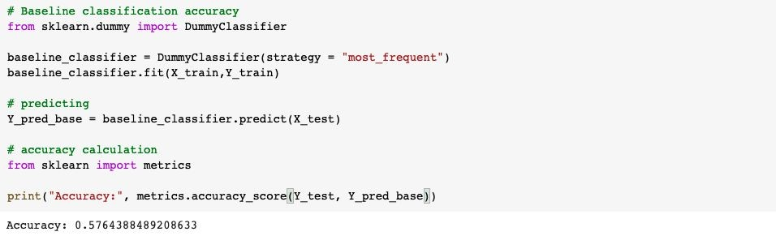
Baseline Model
We decided to create a baseline classification model as a benchmark
A simple model that provides reasonable results on a task or a metric you would hope any model could beat.
DummyClassifier is a classifier that makes predictions using simple rules. We use this to build a
baseline model to compare with other models.
The baseline model has a 57.64% accuracy, which indicates the lowest possible prediction we can get. We expect to get higher accuracy from other models we selected.
●
●

Slide 13
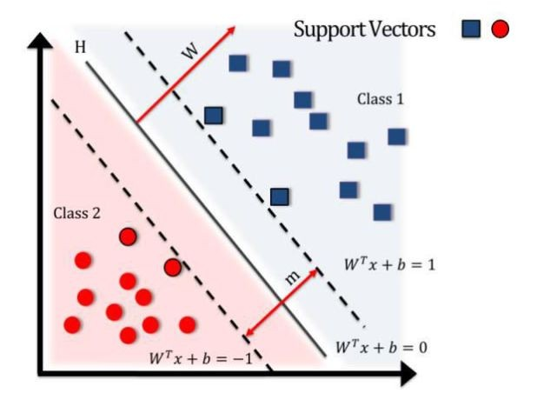
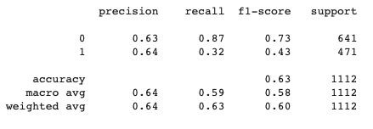
SVM Model
Support vector machines (SVMs) are a set of supervised learning methods used for classification, regression, and outliers detection.Given labeled training data (supervised learning), the algorithm outputs an optimal hyperplane which categorizes new examples.
The accuracy rate of the SVM model is 63.49%, the cross validation score is 60.91%.
The precision rate of the SVM model is 64%, the false-positive rate is 87% which indicates is not good fit.

Slide 14
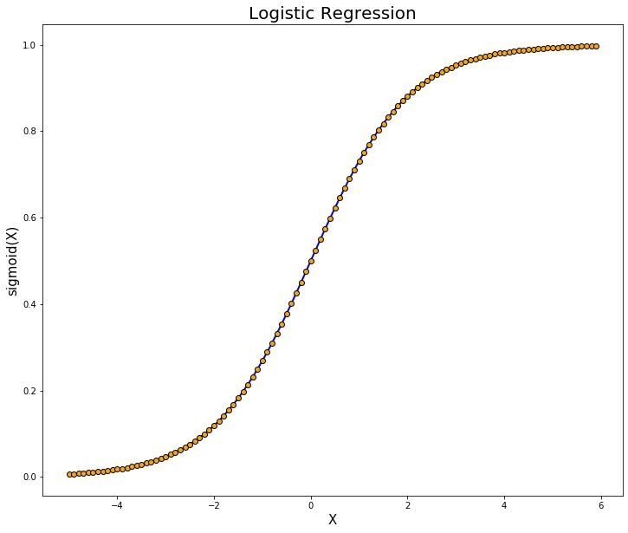
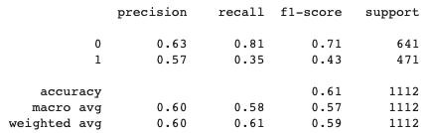
Logistic Regression Model
Logistic regression is a supervised learning classiﬁcation algorithm used to predict the probability of a target variable. It is mainly used when the target variable is categorical.
The accuracy is 61.33%, cross-validation is 60.62%, the accuracy and cross-validation score are not high, but they are close to each other.
The precision rate is 57%, and the false positive rate is 81% which shows this is not a good model for our dataset.

Slide 15
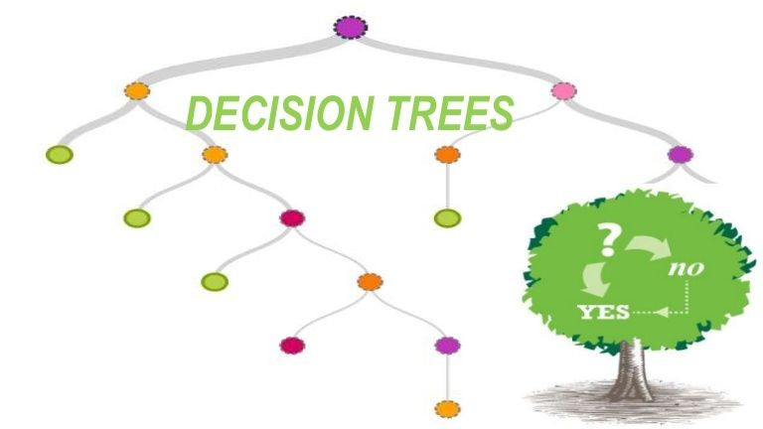
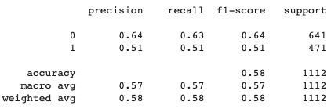
Decision Tree Model
The goal of using a Decision Tree model is to create a training model that can be used to predict/classify the value of the target variable by learning simple decision rules inferred from training data.
Decision Tree Model result shows the accuracy as 57.37% and cross validation score as 56.71%.
The precision rate is 51%, false positive rate is 62% which shows this is not a good model
for our dataset.

Slide 16
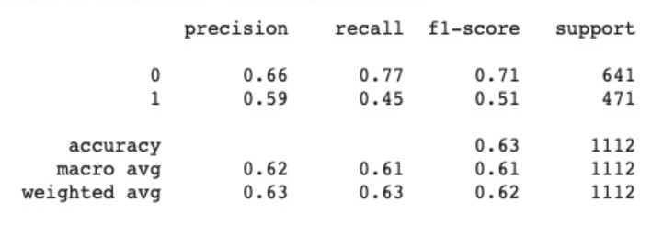
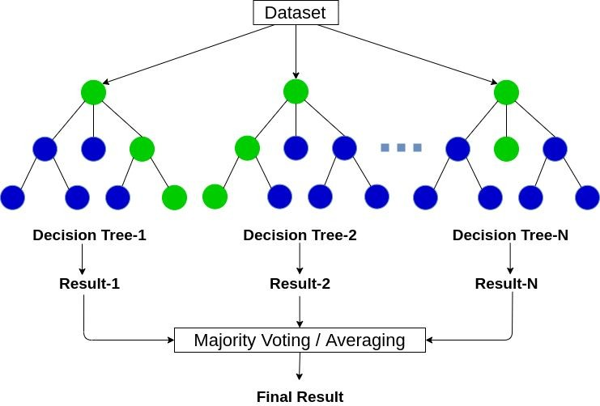
Random Forest Model
A random forest is a supervised machine learning algorithm that is constructed from decision tree algorithms.
- Does not suffer overﬁtting, cancel biases from taking average of predictions.
Accuracy of Random Forest Model = 63.40% Cross-validation score = 63.62%

Slide 17
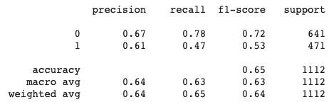
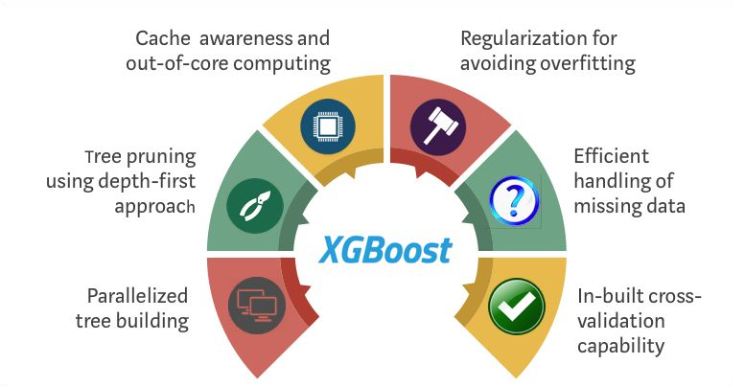
XGBoost Model
XGBoost is a decision-tree-based ensemble ML algorithm.
Uses gradient boost framework
Delivers more accurate approximations by using the second order derivative of the loss function.
Accuracy of XGBoost Model = 65.10% Cross-Validation score = 64.12%

Slide 18
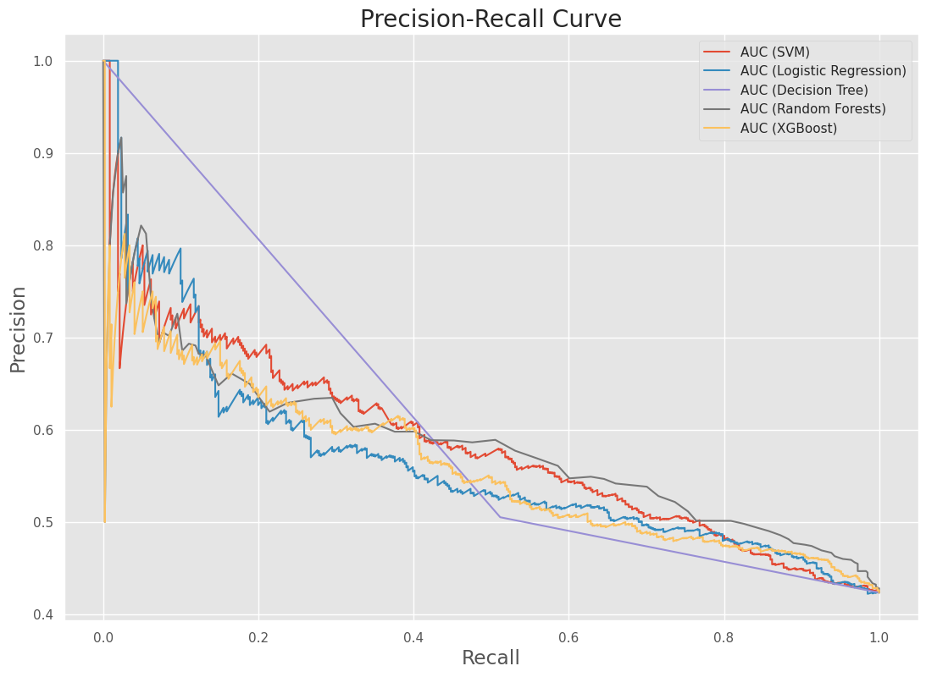
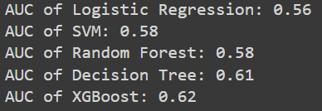

Model Evaluation
Precision: how much was correctly classiﬁed as positive out of all the positives.
Recall: the ratio between how much was correctly identiﬁed as positive to all the actual positives.
F1-score: the weighted average between precision and recall.

Slide 19
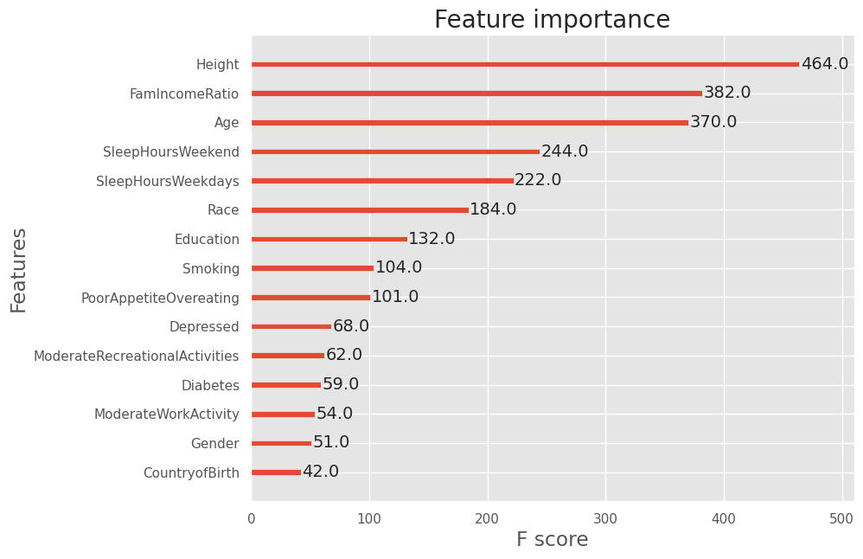
Conclusion
Feature Importance- XGBoost Model
The XGBoost Model provided the best accuracy score compared to the other models so we decided to check the feature importance
The top 6 risk factors are Height, Family income ratio, Age, Sleep hours on weekdays, Sleep hours on weekends and Race.
In our literature review, we learned that depression can affect obesity levels. However, based on our analysis we can not say that mental health is highly affecting obesity level.

Slide 20
Limitations
Limitations
Limited access to robust open source healthcare datasets due to US laws such as HIPAA (protects sensitive patient health information).
The accuracy levels from our models were considerably low but higher than baseline model.

Slide 21
References
https://blog.ml.cmu.edu/2020/08/31/3-baselines/
https://blog.insightdatascience.com/always-start-with-a-stupid-model-no-exceptions-3a22314b9aaa https://xgboost.readthedocs.io/en/latest/python/python_api.html https://www.datacamp.com/community/tutorials/random-forests-classifier-python

Slide 22
THANK YOU!!

